Slide 1








DIGITAL. INNOVATION. SCALE

Slide 2


Agenda
Composite design patterns
What is Composite Design Pattern
When to use
Examples
Pros and Const
What we need
Questions and answers

Slide 3
What is Composite Design Pattern
Structural Design Pattern
Compose objects into tree structures to represent part-whole hierarchies. Composite lets clients treat individual objects and compositions of objects uniformly.
How can a part-whole hierarchy be represented so that clients can treat individual objects and compositions of objects uniformly?

Slide 4
What is Composite Design Pattern
The Composite pattern describes how to solve such problems:
Compose objects into tree structures to represent part-whole hierarchies.
Define separate Composite objects that compose the objects in a part-whole hierarchy into tree structures.
Clients work through a common Component interface to treat Leaf and Composite objects uniformly, which greatly simplifies clients and makes them easier to implement, change, test, and reuse.

Slide 5
What is Composite Design Pattern
The Composite pattern describes how to solve such problems:
Compose objects into tree structures to represent part-whole hierarchies.
Define separate Composite objects that compose the objects in a part-whole hierarchy into tree structures.
Clients work through a common Component interface to treat Leaf and Composite objects uniformly, which greatly simplifies clients and makes them easier to implement, change, test, and reuse.

Slide 6
Example

Slide 7
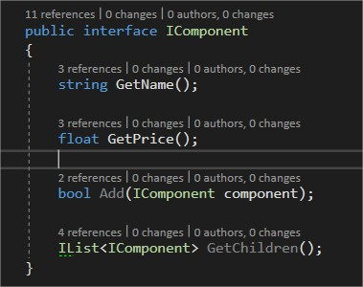
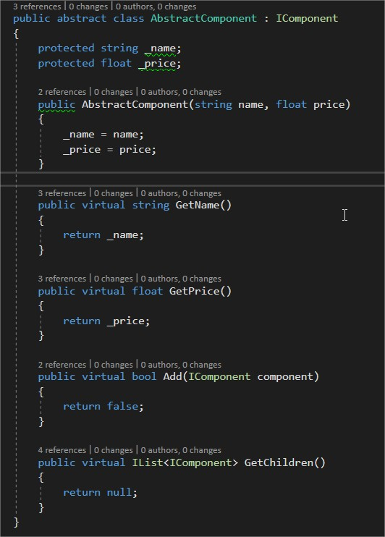
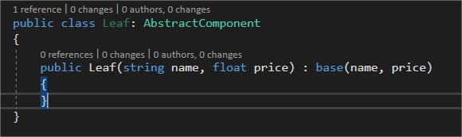
Example

Slide 8
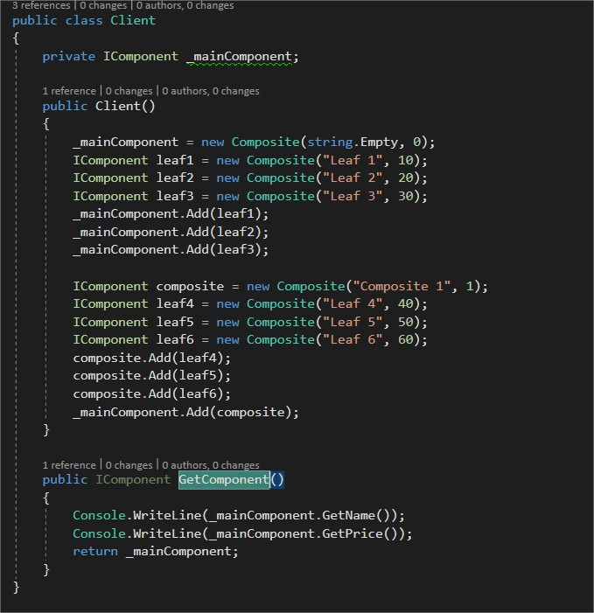
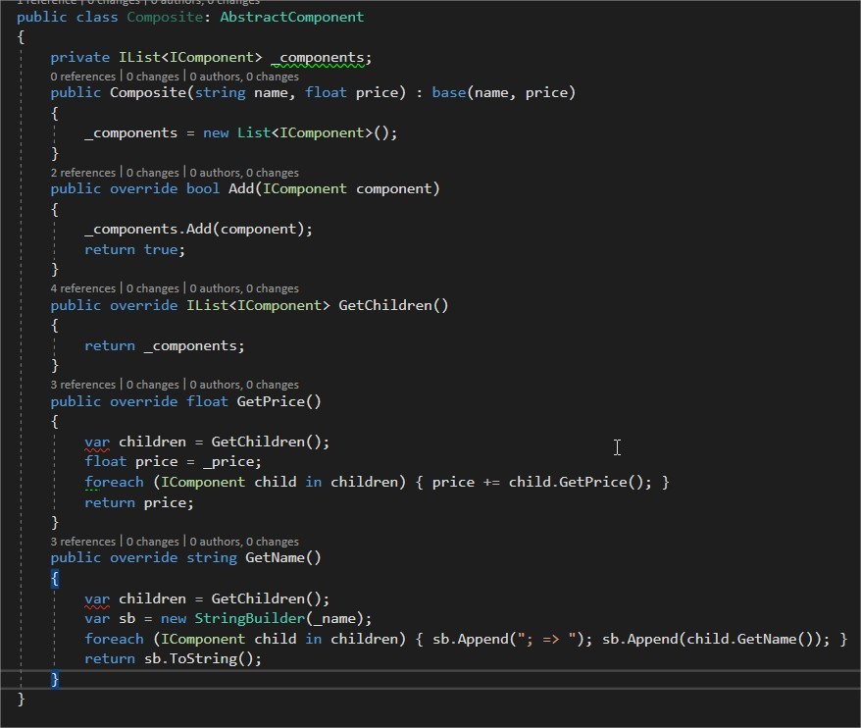
Example

Slide 9
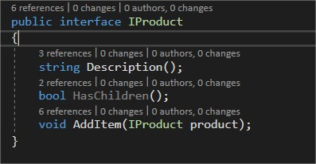
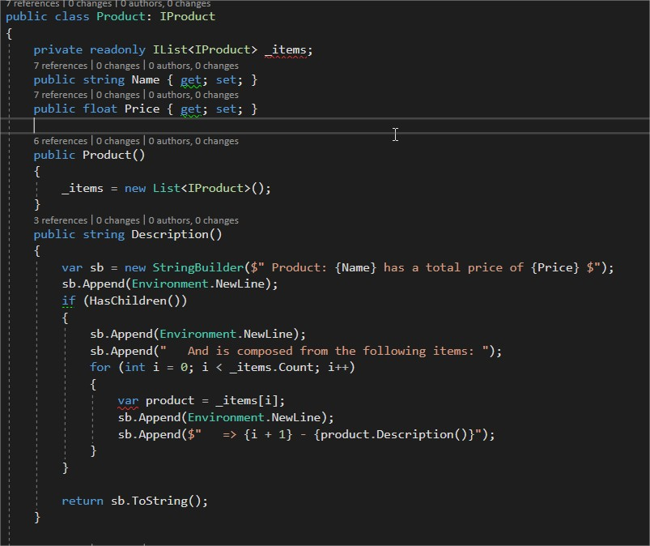
Example

Slide 10
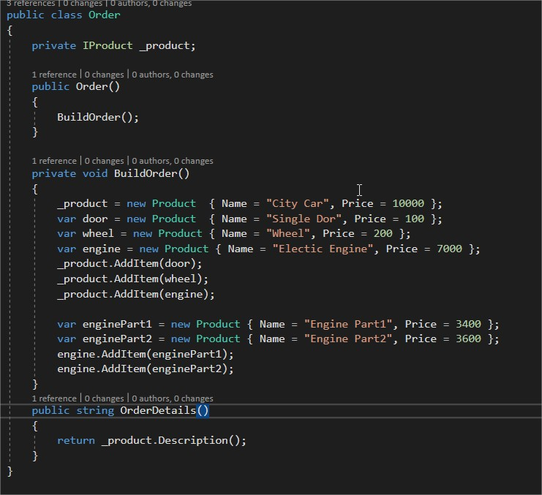
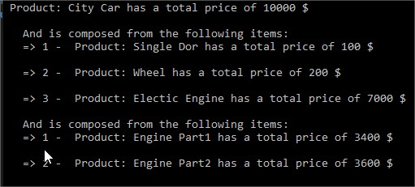
Example

Slide 11
What we need
Participants
Client
Component
Leaf
Composite

Slide 12
Advantages / Disadvantages
Simplifies clients.
Makes adding new components easy.
Allows building and changing complex hierarchies dynamically at run-time.
Disadvantages
Uniformity vs Type Safety.

Slide 13
Questions

Slide 14
References
GOF – Design Patterns - http://www.w3sdesign.com/GoF_Design_Patterns_Reference0100.pdf
Dotfactory - https://www.dofactory.com/net/design-patterns
Code example - https://gitlab.softvision.ro/enterprise.net/design-patterns/composite
Git hub: https://github.com/svdcretu/designPatterns/tree/master/Structural/Composite

